Slide 1
Lec 2

Slide 2
Content
Forward vs Store and forward transmission
Hops in a network
Dealy, bandwidth, throughput, Loss, latency
Types of delays
Total transmission time
Concept of traceroute and Ping
Forwarding table in routing protocols
Internet ISP
Network of Networks
Network under attacks
Notes:
https://www.youtube.com/watch?v=Ofjsh_E4HFY&t=446s

Slide 3
Store and forward transmission
Forward transmission
Hub, Switch
Store and forward transmission
Router

Slide 4
Hops in a Network
How many times a packet or a message jumps from one router to another while travelling towards destination.
00
When a packets moves from source to destination, it passes through several hops, at each hop(router), packet is processed and then passed to the next hop.

Slide 5
Latency, Delay, Bandwidth and Throughput
Latency: How much time it takes for a data packet to travel from one designated point to another. It is also called delay or total transmission time or total delay.
Bandwidth: Maximum amount of data that can be transmitted over a communication channel in a single amount of tim.
Throughput: Actual amount of data transmitted from source to destination in a unit time. (Number of messages transmitted per unit time)
Jitter: Variation in delay time (Causing flickering images on screen)
Loss: Also known as packet lost. It occurs when one or more packets fail to arrive at the destination.
Notes:
https://www.youtube.com/watch?v=wo3M5G9ZHo0

Slide 6
Types of Delays
Transmission delay amount of time taken to put a message or a packet on a transmission medium. Also known as transmission delay.
Transmission delay = Length of a message / Bandwidth
00
Propagation delay Amount of time taken to transfer a message from source to destination.
= Distance/Speed
Queueing delay Amount of time a packet is waiting in a buffer before getting transmitted. No formula to calculate it.
Processing delay Amount of time a router takes in processing a packet before forwarding it. No formula to calculate it.
Nodal delay
End to end delay
Queuing delay, processing delay, and nodal delay only occurs in packet switching.

Slide 7
Total Transmission Time (Total Delay)
Packet switch
= n (Transmission delay) + Propagation delay OR
= td + pd +qd + pd
Circuit switch
Transmission delay + Propagation delay + Tear down time + Setup Time
FDM
Transmission time = Message /(Transmission rate/ slots)
TDM
Transmission time = Message /(Transmission rate/frame rate*frame size)

Slide 8
Access Network
Access network is a physical link that connects edges or end systems to the edge router. Edge router is the first router on a path from end system to ISP
0
Home Access
Enterprise Access
Mobile Access

Slide 9
Home Access
Dial Up modem: Connection established by using modem. Modem is connected to a telephone line to which is connected to ISP. It uses PSTN to connect to ISP.
0
DSL: (Digital Subscriber Line) a modem technology that uses existing telephone lines to transport high-bandwidth data, such as multimedia and video, to service subscribers. DSL provides dedicated, point-to-point, public network access. This DSL connection is typically between a network service provider (NSP) central office and the customer site.
0
Difference: DSL is hundred times faster than Dial Up modem. DSL allow you to use internet while using telephone whereas Dial Up dont.
0
HFC: (Hybrid Fiber Coaxial cables) architecture tha use a combination of fiber optic cabling and coaxial cabling to distribute video, data and voice content to/from the headend and the subscribers.

Slide 10
Enterprise Access
Uses Ethernet to connect an enterprise network to ISP

Slide 11
Mobile Access
Mobile devices are connected to base station, base station connect them to the wired network.

Slide 12
Broadband
The term broadband refers to high-speed and high-bandwidth communication infrastructure.
Six of broadband technologies: digital subscriber line (DSL), cable modem, fiber, wireless, satellite, and broadband over power lines (BPL).
The bulk of Internet users (92.6%) across the globe access broadband through their mobile phones.

Slide 13
Network of Networks
Local network connected to the Internet through tiered hierarchy of Internet Service providers.
Access ISP or tier-3 ISP are at the bottom (Jazz)
Tier-2 ISP connecting national networks to internet or to global network (PTCL)
Tier-1 ISP also known as network backbone are international ISP (Sprint, UUNet, AT&T))
Point of Presence Point where one ISP is connected to another ISp. Usually one or more routers connected to each other.

Slide 14
Layering in Computer Networks
Layering: Decomposing a complex problem or a system into smaller more manageable parts or layers.
Organization of a program into separate functional components that interact with each other in sequential and hierarchical manner.
Advantages:
Layered architecture makes it easy to dissect, understand, and change a complex system.
It makes error finding and detection easier.

Slide 15
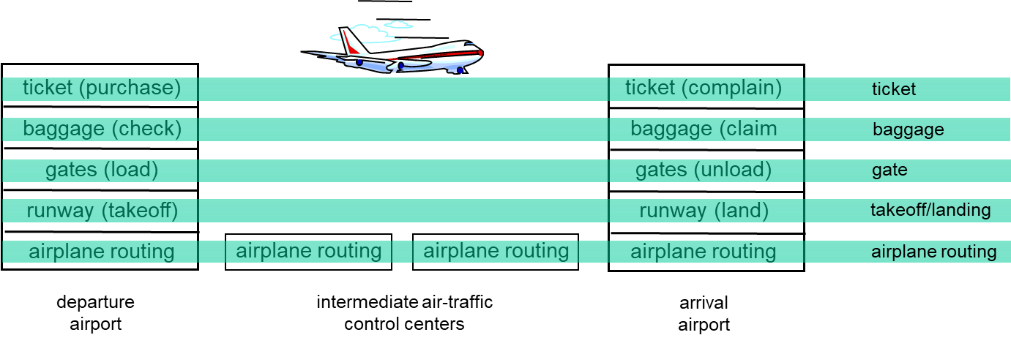
Example of Layering
Each layer implements a service
Via its own internal-layer actions
Relying on services provided by layer below

Slide 16
Layered Computer Architecture
Organization of network protocols, software, and hardware into layers.
With this architecture, each protocol belongs to one layer.
Layers communicate with each other by exchanging messages called “layer n protocol data units” or simple “n-PDU”.
Protocols at each layer governs the activities of that layer
Set or group of protocols running concurrently a different layers is called protocol stack.

Slide 17
Layered Architectures
OSI Reference model
TCP/IP model

Slide 18
ISO/OSI Reference Model
Open System Interconnection developed by International Standard for Organizations.
It is a model or a set of guidelines for designing a network that is robust, flexible, and interoperable.
It is just a guideline, neither a software nor a protocol and therefore is called OSI reference model.
Purpose is to facilitate communication between two systems without getting into underlying hardware and software of the system.

Slide 19
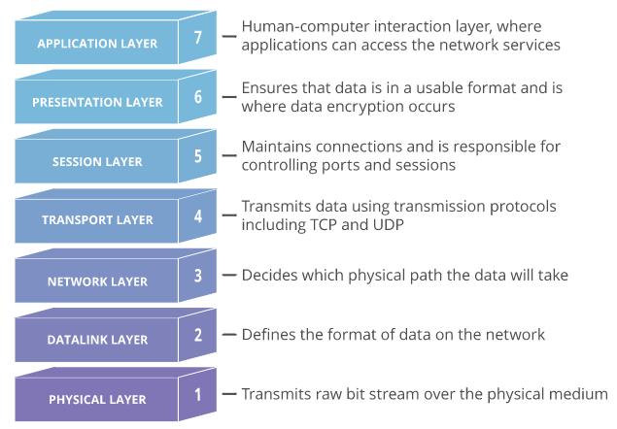
OSI Reference Model

